Slide 1
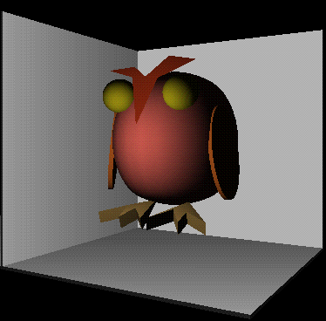
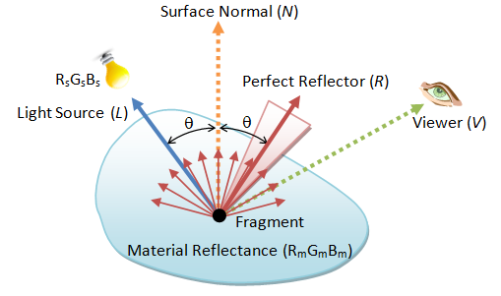
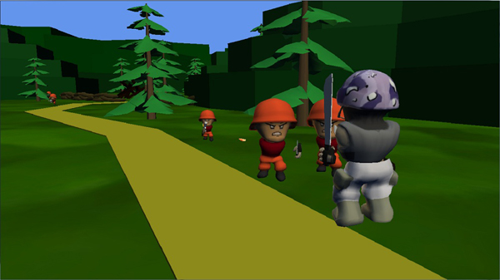
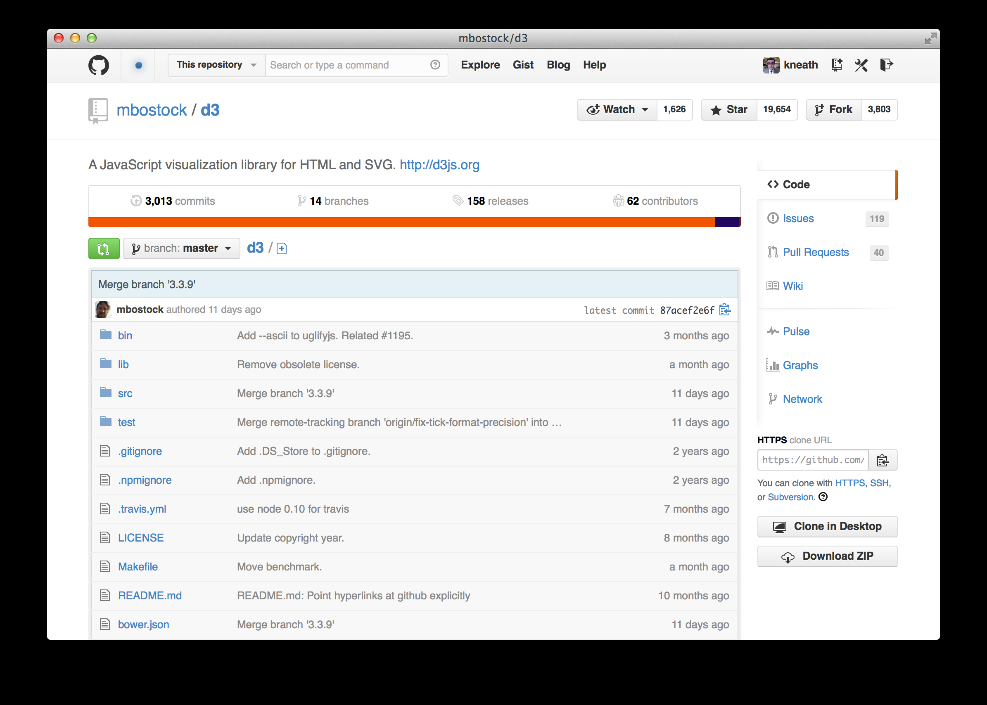
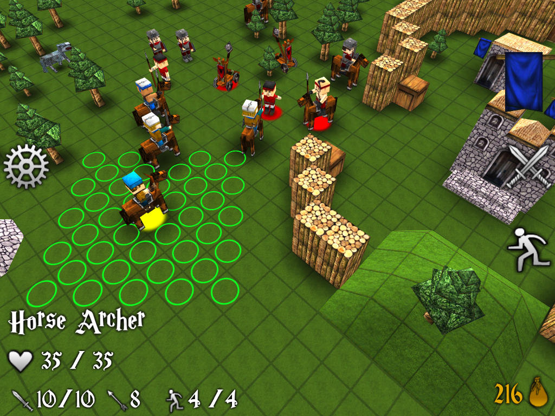
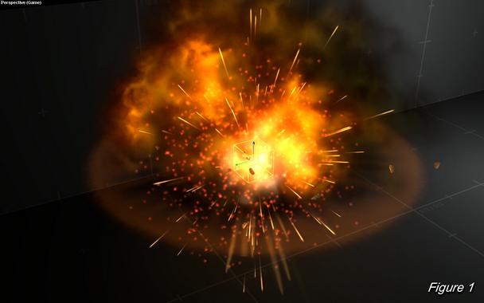
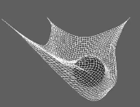
Render Targets & Viewports
Advanced Games Programming (CGP600)

Slide 2
Overview
Render `targets’
Animation (Movement)
Swap-Chains
Superimposing (e.g., HUD)
Viewports
Split Screen
Scaling/Resampling
Examples

Slide 3
Render “Targets”

Slide 4
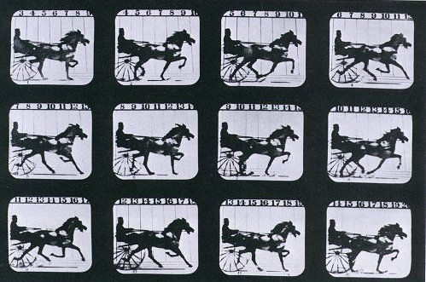
Animation

Slide 5

Animation

Slide 6
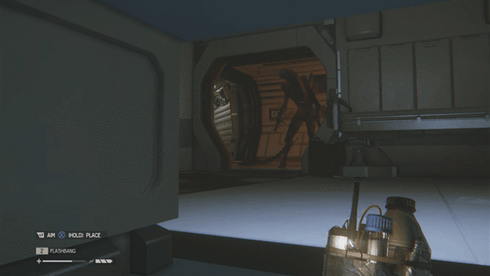
Animation

Slide 7
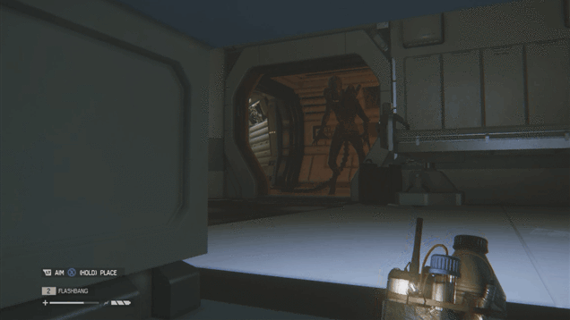
Animation

Slide 8
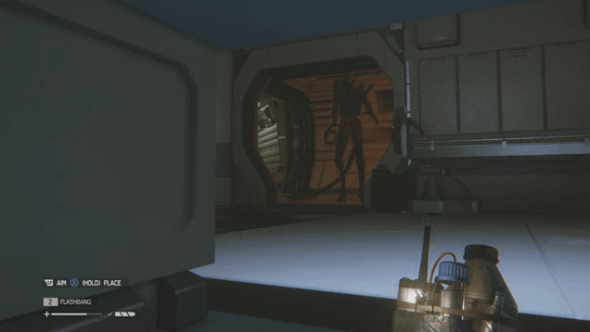
Animation

Slide 9

Animation

Slide 10

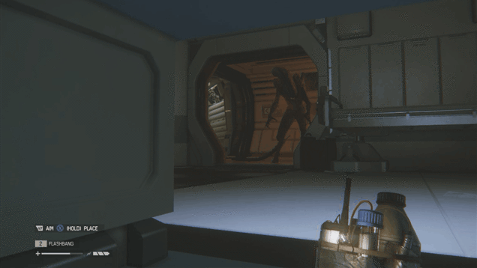


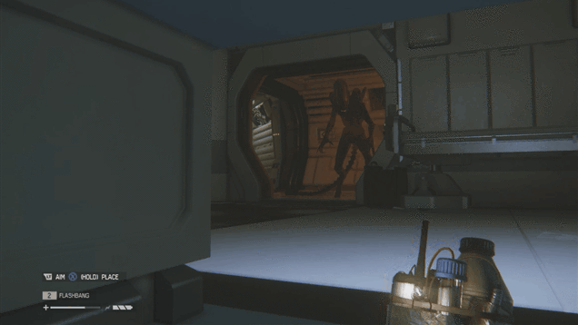
Animation
0 secs
Frame 0
Animation running at 30 FPS
(Frames Per Second)
Frame 5
Frame 10
0.5 secs
Frame 15
Frame 20
Frame 25
1.0 secs
Frame 30
Frame 35
Frame 40
1.5 secs
Frame 45
Frame 50
Frame 55
2.0 secs

Slide 11
Back Buffers
With SDL, ALL drawing was done to the back buffer automatically:
screen buffer (currently being displayed)
current back buffer

Slide 12
Back Buffers
With every draw command, the new frame is build up:
CLEAR SCREEN TO COLOUR:
screen buffer (currently being displayed)
current back buffer

Slide 13
Back Buffers
With every draw command, the new frame is built up:
Draw a rectangle at screen coords (100, 100):
screen buffer (currently being displayed)
current back buffer

Slide 14
Back Buffers
With every draw command, the new frame is built up:
Flip the display (back buffer becomes screen buffer)
screen buffer (currently being displayed)
current back buffer

Slide 15
Back Buffers
With every draw command, the new frame is built up:
Flip the display (back buffer becomes screen buffer)
current being displayed
current back buffer

Slide 16
Back Buffers
With every draw command, the new frame is built up:
CLEAR SCREEN TO COLOUR:
screen buffer (currently being displayed)
current back buffer

Slide 17
Back Buffers
With every draw command, the new frame is built up:
Draw a rectangle at screen coords (120, 100):
screen buffer (currently being displayed)
current back buffer

Slide 18
Back Buffers
With every draw command, the new frame is built up:
Flip the display (back buffer becomes screen buffer)
screen buffer (currently being displayed)
back buffer

Slide 19
Back Buffers
With every draw command, the new frame is built up:
CLEAR SCREEN TO COLOUR:
screen buffer (currently being displayed)
back buffer

Slide 20
Back Buffers
With every draw command, the new frame is built up:
Draw a rectangle at screen coords (140, 100):
screen buffer (currently being displayed)
back buffer

Slide 21
Back Buffers
With every draw command, the new frame is built up:
Flip the display (back buffer becomes screen buffer)
screen buffer (currently being displayed)
back buffer

Slide 22
Back Buffers
With every draw command, the new frame is built up:
CLEAR SCREEN TO COLOUR:
screen buffer (currently being displayed)
back buffer

Slide 23
Back Buffers
Every screen flip presents a new frame.
Frames displayed sequentially give illusion of motion.

Slide 24
Back Buffers
Same thing is happening in Direct X:
Call pSwapChain->Present() to swap back buffer with screen buffer:
Build up next frame on back buffer while current frame is displayed
Draw to the backbuffer:
screen buffer (currently being displayed)
screen buffer (currently being displayed)
screen buffer (currently being displayed)
Draw more stuff here
back buffer
back buffer
back buffer

Slide 25
Render Targets
The screen (or front) buffer and back buffer are examples of Render Targets
Draw more stuff here
screen buffer (currently being displayed)
back buffer (default render target)
A render target is an area of memory where pixels can be drawn to.

Slide 26
Swap Chains
A Swap Chain can support more render targets than just the screen buffer and a back buffer
That means we have flexibility with what we’re drawing to screen
And we can get clever with how we do it…

Slide 27
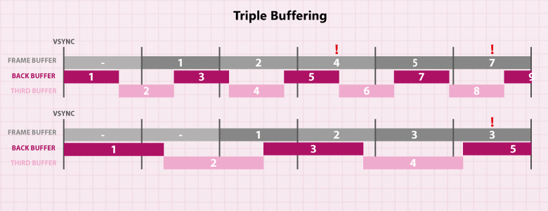
Swap Chains
A Swap Chain can support more render targets than just the screen buffer and a back buffer
e.g.:
Triple Buffering
(avoid screen tearing, maintain frame count)
https://www.anandtech.com/show/2794/2

Slide 28
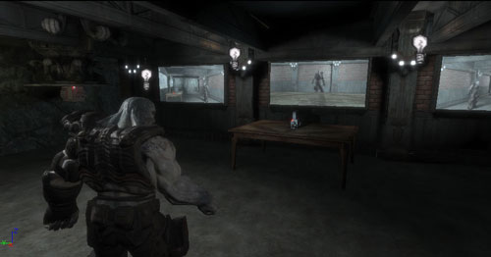
Swap Chains
A Swap Chain can support more render targets than just the screen buffer and a back buffer
Useful for:
Rendering to Textures
(in-game real-time screens, reflective surfaces)

Slide 29
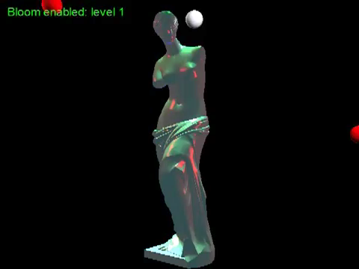
Swap Chains
A Swap Chain can support more render targets than just the screen buffer and a back buffer
Useful for:
Post Processing Effects
(blur, bloom, etc)
Daniele Colombo
https://www.youtube.com/watch?v=UVmC-Up-2fw

Slide 30
Viewports

Slide 31
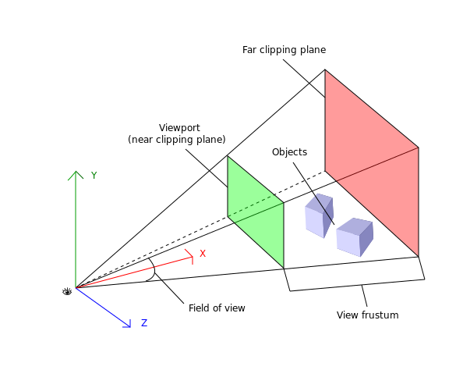
Viewports
A viewport is the rectangle a scene is projected onto:

Slide 32
Viewports
The viewport also determines depth of the view frustum
Objects closer to observation point than near-clipping plane
or further away than far-clipping plane are not rendered.
(more on this in a future lecture)

Slide 33
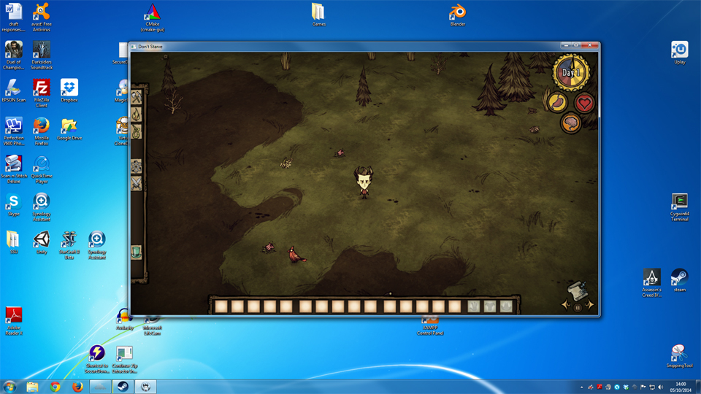
Viewports
NOT the same as the GUI window:

Slide 34
Viewports
NOT the same as the GUI window :
GUI Window

Slide 35
Viewports
(or the render buffer):
buffer
Although most of the time the viewport render fills usable area of buffer

Slide 36
Viewports
Viewport
render
Although most of the time the viewport render fills usable area of buffer

Slide 37
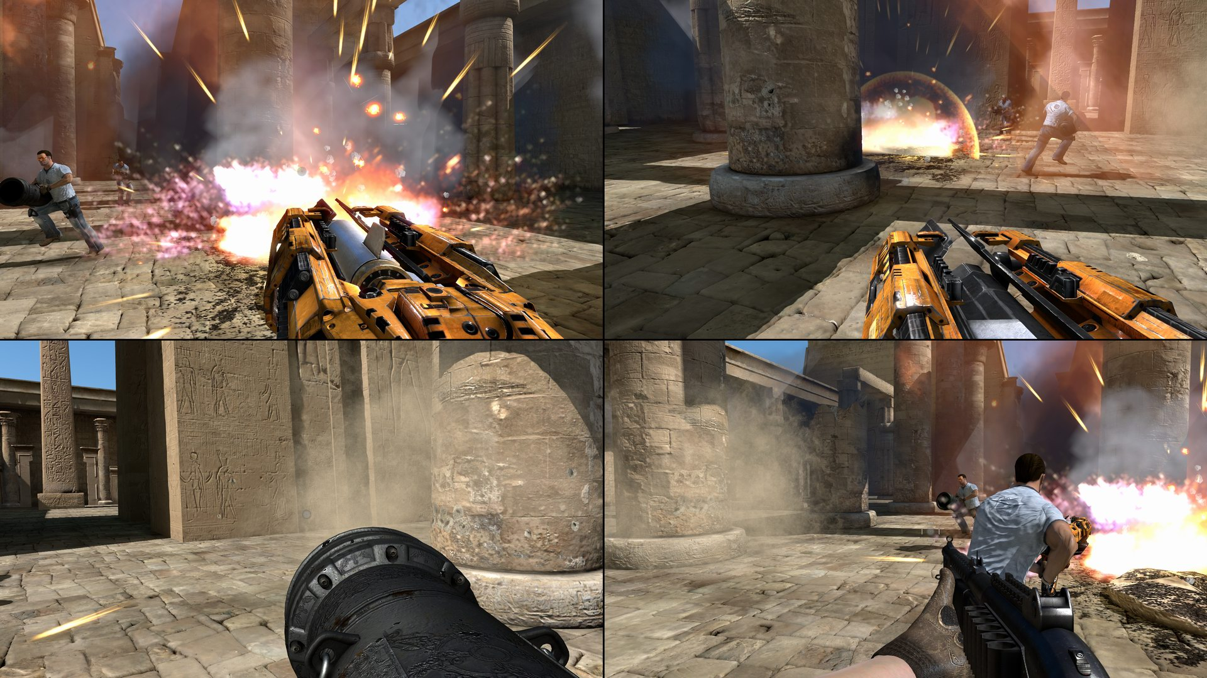
Viewports
However, you can have MULTIPLE viewports rendering to the buffer:

Slide 38
Viewports
Viewport 1
Viewport 2
Viewport 3
Viewport 4
…and can be other sizes – useful for multiplayer views…

Slide 39
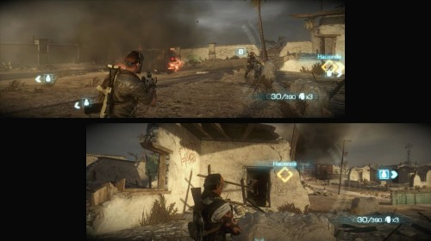
Viewports
…and you can get creative with size and positioning…

Slide 40
Viewports
Viewport 1
Viewport 2
…and you can get creative with size and positioning…

Slide 41
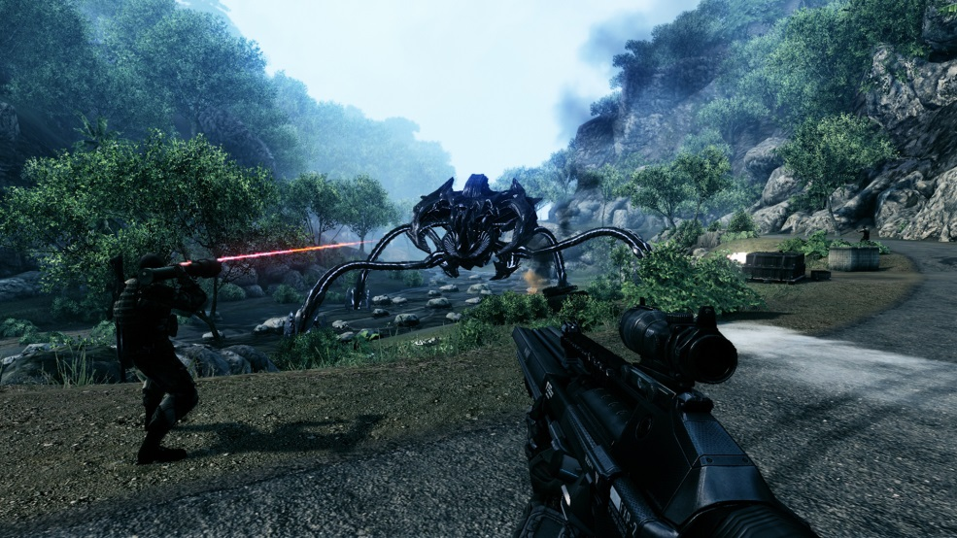
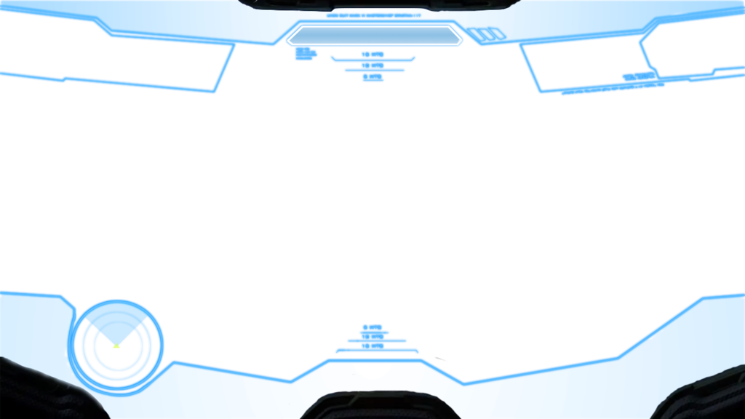
Viewports
Or you can also superimpose viewport renders
+
Halo 4 HUD by AlexNator
http://www.deviantart.com/art/Halo-4-HUD-327587902
Crysis 3 Screenshot
http://www.gamingtruth.com/2011/10/11/crysis-xbox-360-review/

Slide 42

Viewports

Slide 43
Questions to explore
Why use render targets (back/front buffer)?
What are the limitations/problems?
Why use a swap-chain?

Slide 44
Further reading
Real-time Frame rate up-conversion for video games (SIGGRAPH 2010)
http://and.intercon.ru/rtfrucvg_html_slides/
Blooming (in XNA)
http://digitalerr0r.wordpress.com/2009/10/04/xna-shader-programming-tutorial-24-bloom/
Simple 3D effect
http://www.mymodernmet.com/profiles/blogs/3d-gifs

Slide 45
Summary
Understand the whats and whys of:
Render Targets and how they connect to swap-chains
Viewports and multiple-views

Slide 46
To do this week…
Read over the lectures
Practicals
Challenging – hence, start early
Setup source control – (i.e., Github)
Work through tutorial practicals
Guide 01, 02, Tutorial 01, …
Experiment (get into good habits)

